Slide 1
swapping

Slide 2
Standard Swapping
Standard swapping involves moving processes between main memory and a backing store ( commonly a fast disk ). It must be large enough to accommodate copies of all memory images for all users, and it must provide direct access to these memory images.
The system maintains a ready queue consisting of all processes whose memory images are on the backing store or in memory and are ready to run. Whenever the CPU scheduler decides to execute a process, it calls the dispatcher.
The dispatcher checks to see whether the next process in the queue is in memory. If it is not, and if there is no free memory region, the dispatcher swaps out a process currently in memory and swaps in the desired process. It then reloads registers and transfers control to the selected process.
Major part of swap time is transfer time; total transfer time is directly proportional to the amount of memory swapped

Slide 3
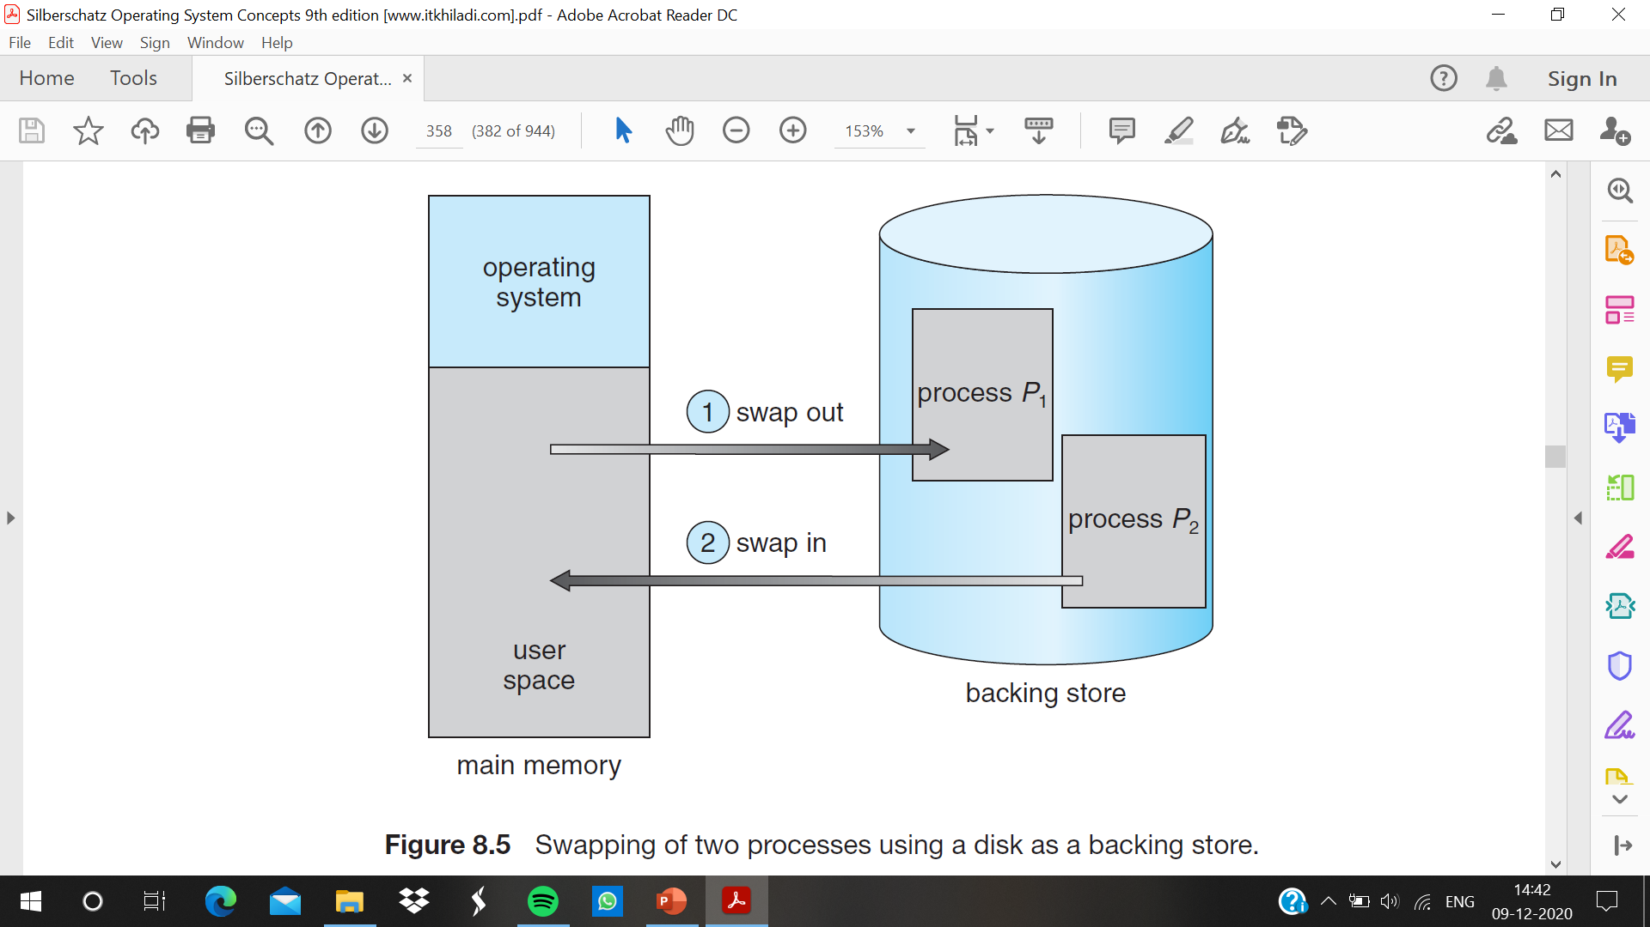

Slide 4
Disadvantage of swapping
Standard swapping is not used in modern operating systems. It requires too much swapping time and provides too little execution time to be a reasonable memory-management solution.
Modified versions of swapping, however, are found on many systems, including UNIX, Linux, and Windows. In one common variation, swapping is normally disabled but will start if the amount of free memory (unused memory available for the operating system or processes to use) falls below a threshold amount.
Swapping is halted when the amount of free memory increases. Another variation involves swapping portions of processes—rather than entire processes—to decrease swap time.

Slide 5
Context – switch and swapping
The context-switch time in such a swapping system is fairly high . To reduce context switch time by knowing how much memory is really being used. System calls to inform OS of memory use: request_memory() and release_memory()
Swapping is constrained by other factors as well. If we want to swap a process, we must be sure that it is completely idle.
never swap a process with pending I/O, or execute I/O operations only into operating-system buffers.
Transfers between operating-system buffers and process memory then occur only when the process is swapped in. This double buffering itself adds overhead. It need to copy the data again, from kernel memory to user memory, before the user process can access it.

Slide 6
Swapping on Mobile Systems
mobile systems typically do not support swapping in any form. Mobile devices generally use flash memory rather than more spacious hard disks as their persistent storage.
Reason : the limited number of writes that flash memory can tolerate before it becomes unreliable and the poor throughput between main memory and flash memory in these devices.
Apple’s iOS asks applications to voluntarily relinquish allocate memory. Read-only data (such as code) are removed from the system and later reloaded from flash memory if necessary
Android does not support swapping and adopts a strategy similar to that used by iOS. It may terminate a process if insufficient free memory is available. However, before terminating a process, Android writes its application state to flash memory so that it can be quickly restarted.

